Slide 1
Basic Data Structures
Arrays, Linked-list, Stack, and Queue
Santosh Kumar Verma
Mentor-GeeksforGeeks

Slide 2



Arrays

Slide 3
Arrays
Array Basics:
Definition and its purpose in programming.
Declare and initialize in various programming languages.
One-dimensional array VS multi-dimensional array.
Array Operations:
Write a program to find the sum/average of elements in an array.
Implement a function to reverse the elements of an array.
Write a program to search for a specific element in an array.
Explain and provide examples of array slicing.
Sorting and Searching:
Implement a sorting algorithm (e.g., bubble sort, insertion sort) for an array.
Write a program to perform a binary search on a sorted array.
Compare the time complexity of different sorting algorithms.
Array Manipulation:
Write a program to merge two sorted arrays.
Implement a function to remove duplicates from an array.
Write a program to rotate the elements of an array to the right/left.
Dynamic Arrays:
Explain the concept of dynamic arrays (e.g., ArrayList in Java, List in Python, Vector in C++).
Compare static arrays and dynamic arrays in terms of advantages and disadvantages.
String Manipulation (as an array of characters):
Explain how strings are represented using character arrays.
Write a program to concatenate two strings.
Implement a function to check if two strings are anagrams.
Memory Allocation:
Discuss the memory allocation of arrays in languages like C/C++.
Error Handling:
Identify common errors associated with array manipulation (e.g., index out of bounds, null reference).
Write error-handling code for array-related operations.

Slide 4
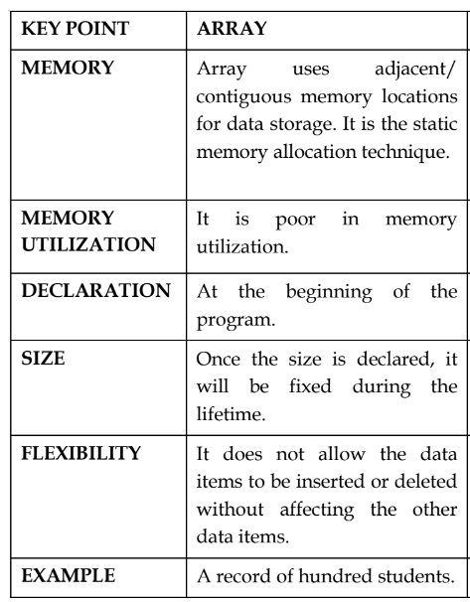
Basics of Array
Syntax:
Datatype Array_Name[ size];
Datatype Array_Name[ row][ column];
Datatype Array_Name [depth/Layers] [row] [column];
Operations:
Insert, Delete, Search, Sort, Traverse, Rotate, Merge..
Add, Sub, Mul, Div, Transpose, Inverse…
Arrays in Memory:
1D – Contiguous
Multidimensional – Row Major/Column Major

Slide 5
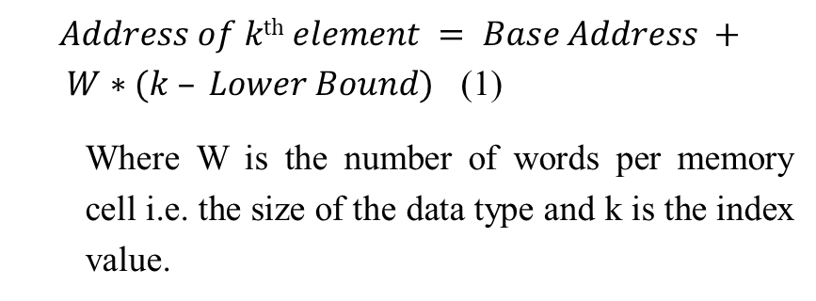
Arrays in Memory
One Dimensional
Two Dimensional
$Address of k\text{th} element = Base Address + W∗(k – Lower Bound)$ (1)
Where W is the number of words per memory cell i.e. the size of the data type and k is the index value.

Slide 6
Operations on one dimensional array:
Traversal: It is the process of visiting or processing each element exactly once.
Search: search is the process of finding the location or the physical address for a given value.
Deletion: Deletion is the process of removing an element form the array.
Insertion: Insertion is the process of adding a new data value to the existing array.
Sorting: Sorting is the process of arrangement or organization of elements in an order (ascending or descending).
Merge: It is a process of combining two array sequences in a specified order (ascending or descending).
Reverse: It is used to reverse the entire sequence.

Slide 7
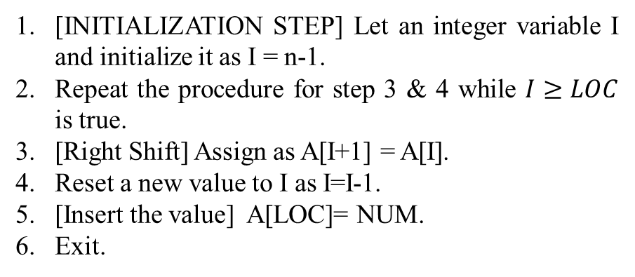
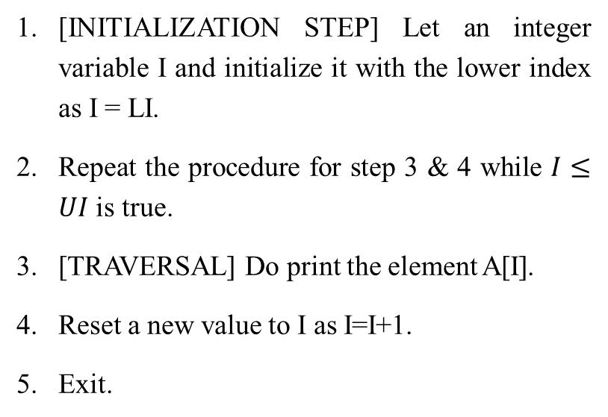
Traversal of a linear array:
Insertion of an element into a linear array:
[INITIALIZATION STEP] Let an integer variable I and initialize it with the lower index as I = LI.
Repeat the procedure for step 3 & 4 while $I≤UI$ is true.
[TRAVERSAL] Do print the element A[I].
Reset a new value to I as I=I+1.
Exit.
[INITIALIZATION STEP] Let an integer variable I and initialize it as I = n-1.
Repeat the procedure for step 3 & 4 while $I≥LOC$ is true.
[Right Shift] Assign as A[I+1] = A[I].
Reset a new value to I as I=I-1.
[Insert the value] A[LOC]= NUM.
Exit.

Slide 8
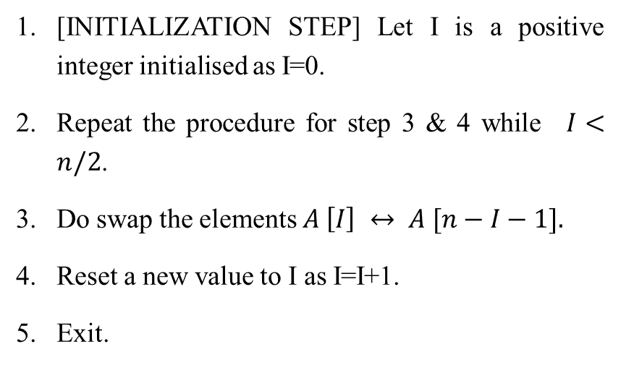
Deletion of an element from a linear array:
Reversing the linear array:
 | Given Array Sequence
 | 0 | 1 | 2 | 3 | 4 | 5 | 6 | 7 | 8
A | B | C | D | E | G | H | I | J | K
 | 0 | 1 | 2 | 3 | 4 | 5 | 6 | 7 | 8
A | B | C | D | E | G | H | I | J | K
 | Left Shift
 | After Left Shift
 | 0 | 1 | 2 | 3 | 4 | 5 | 6 | 7 | 8
A | B | C | D | E | H | I | J | K | K
 | After Deletion from Index 4.
 | 0 | 1 | 2 | 3 | 4 | 5 | 6 | 7 | 8
A | B | C | D | E | H | I | J | K | ‘\0’
[INITIALIZATION STEP] Let I is a positive integer initialised as I=0.
Repeat the procedure for step 3 & 4 while$I<n/2$.
Do swap the elements $A \left[I\right] ↔ A [n−I−1].$
Reset a new value to I as I=I+1.
Exit.

Slide 9
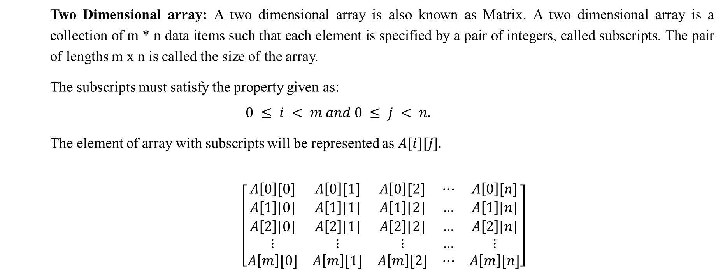
Two Dimensional array: A two dimensional array is also known as Matrix. A two dimensional array is a collection of m * n data items such that each element is specified by a pair of integers, called subscripts. The pair of lengths m x n is called the size of the array.
The subscripts must satisfy the property given as:
$$0 ≤ i < m and 0 ≤ j < n.$$
The element of array with subscripts will be represented as $A[i][j].$
$\left[\begin{matrix}A\left[0\right][0] & A\left[0\right][1] & A\left[0\right][2] & ⋯ & A\left[0\right][n] \\ A\left[1\right][0] & A\left[1\right][1] & A\left[1\right][2] & … & A\left[1\right][n] \\ A\left[2\right][0] & A\left[2\right][1] & A\left[2\right][2] & … & A\left[2\right][n] \\ ⋮ & ⋮ & ⋮ & … & ⋮ \\ A\left[m\right][0] & A\left[m\right][1] & A\left[m\right][2] & ⋯ & A\left[m\right][n]\end{matrix}\right]$

Slide 10

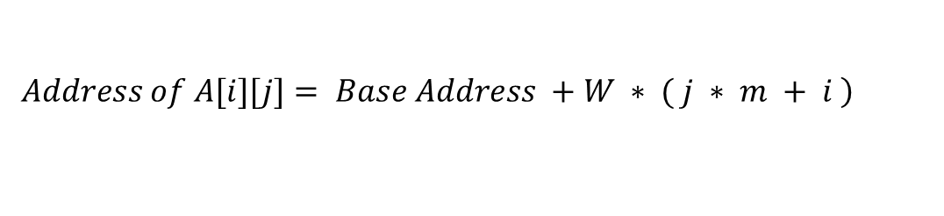
Representation of two dimensional arrays in memory:
Row Major Arrangement:
Column Major Arrangement:
$Address of A[i][j]= Base Address +W ∗ ( i ∗ n + j )$
$$\left.Address of A[i][j]= Base Address +W ∗ ( j ∗ m + i \right)$$

Slide 11
Operations on two dimensional arrays
Matrix Addition
Matrix Subtraction
Matrix Multiplication
Matrix Transpose
Matrix Inverse
Matrix Determinant

Slide 12
Error Handling: Arrays
# Example:
my_array = [1, 2, 3, 4, 5]
# Trying to access an element at a valid index
result1 = my_array[2]
print(f"Result 1: {result1}")
# Trying to access an element at an invalid index
result2 = my_array[10]
print(f"Result 2: {result2}")
# Trying to access an element with an invalid array
result3 = my_array1[2]
print(f"Result 3: {result3}")

Slide 13
Exception Handling in Arrays
def get_element_at_index(arr, index):
try:
# Attempt to access the element at the specified index
result = arr[index]
return result
except IndexError:
# Handle the case where the index is out of bounds
print(f"Error: Index {index} is out of bounds for the array.")
return None
except TypeError:
# Handle the case where 'arr' is not a valid array
print("Error: Invalid array.")
return None
except Exception as e:
# Handle other potential exceptions
print(f“ An unexpected error occurred: {e}")
return None
# Example:
my_array = [1, 2, 3, 4, 5]
# Trying to access an element at a valid index
result1 = get_element_at_index(my_array, 2)
print(f"Result 1: {result1}")
# Trying to access an element at an invalid index
result2 = get_element_at_index(my_array, 10)
print(f"Result 2: {result2}")
# Trying to access an element with an invalid array
result3 = get_element_at_index("not_an_array", 0)
print(f"Result 3: {result3}")

Slide 14
A program P reads in 500 integers in the range [0, 100] representing the scores of 500 students. It then print the frequency of each score above 50. What would be the best way for P to store the frequencies?
GATE CSE 2005
An array of 50 numbers
An array of 100 numbers
An array of 500 numbers
A dynamically allocated array of 550 numbers

Slide 15
An n × n array v is defined as follows V [i, j] = i - j for all i, j, 1≤𝑖≤𝑛,1≤𝑗≤𝑛 The sum of the elements of the array v is
GATE CSE 2000
0
n-1
n^2-3n+2
n^2(n+1)/2

Slide 16
Suppose you are given an array s[1..n] and a procedure reverse (s, i, j) which reverse the order of elements in s between positions i and j (both inclusive). What does the following sequence do, where 1≤𝑘<𝑛:
reverse (s, 1, k); reverse (s, k+1, n); reverse (s, 1, n);
GATE CSE 2000
Rotates s left by k positions
Leaves s unchanged
Reverse all elements of s
None of the above

Slide 17
Two matrices M₁ and M₂ are to be stored in arrays A and B respectively. Each array can be stored either in row-major or column-major order in contiguous memory locations. The time complexity of an algorithm to compute M₁× M₂ will be
GATE CSE 2004
Best if A is in row-major and B is in column-major order
Best if both are in row-major order
Best if both are in column-major order
Independent of the storage scheme

Slide 18

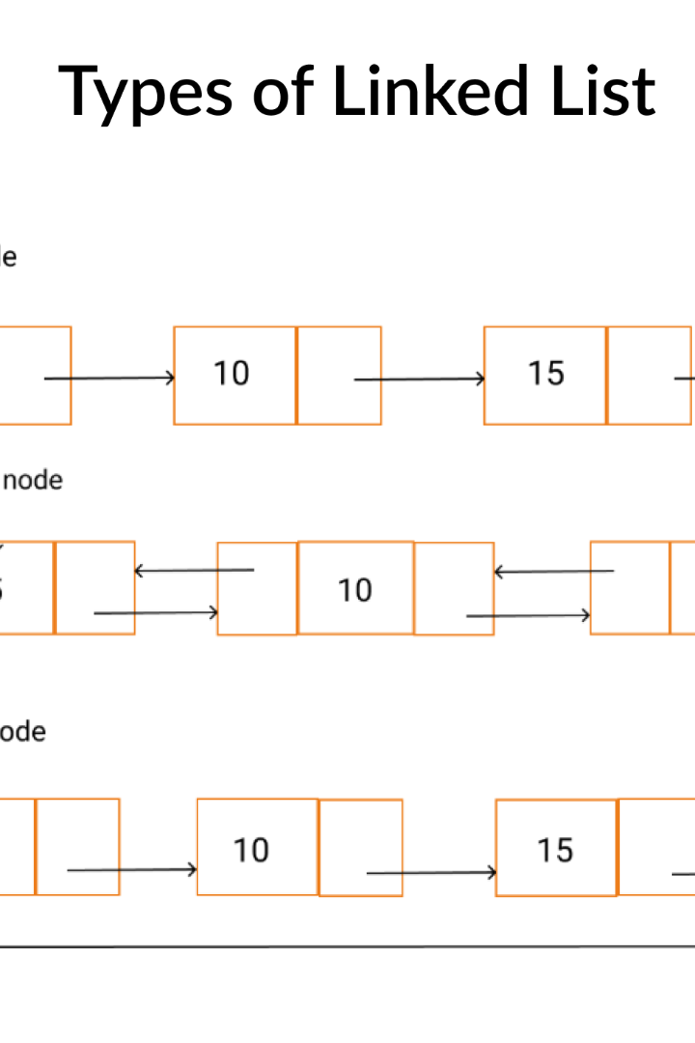
Linked List

Slide 19

Definition of a Linked List
1
A Sequential Collection
A linked list is a linear data structure comprised of nodes that are connected through pointers, forming a chain-like sequence.
2
Flexible and Dynamic
Unlike arrays, linked lists can grow or shrink dynamically by adding or removing nodes at any position.
3
Elementary Components
A node typically contains two key elements: the data it stores and a reference to the next node in the list.

Slide 20
Advantages of Using a Linked List
Efficient Insertions and Deletions
Dynamic Size
Linked lists enable efficient insertion and deletion operations by simply adjusting the pointers, without requiring data movement.
The ability to grow or shrink dynamically makes linked lists ideal for scenarios where the number of elements changes frequently.
Memory Allocation Flexibility
Implementation Simplicity
Nodes in a linked list can be scattered throughout the memory, allowing for flexible memory allocation and efficient use of space.
Implementing and manipulating linked lists is relatively straightforward, making them popular in programming.

Slide 21
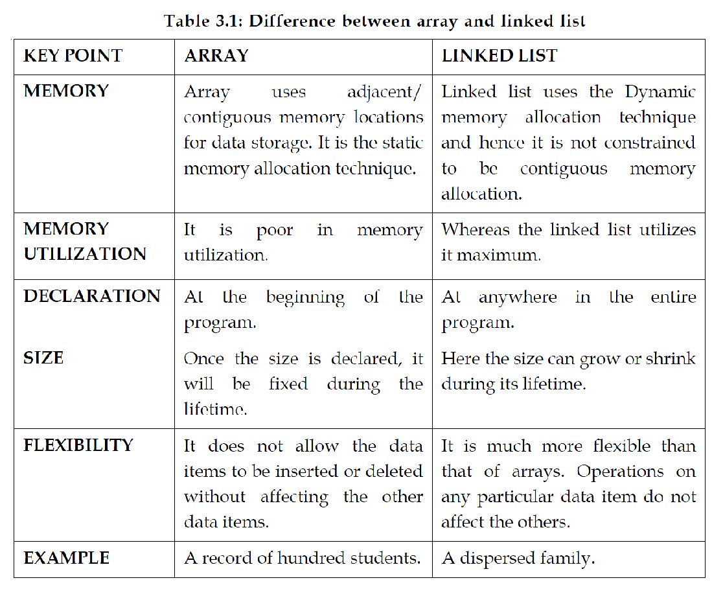
Advantages of Using a Linked List

Slide 22
Comparison with Other Data Structures
Arrays
Stacks and Queues
Trees and Graphs
Linked lists offer dynamic size and efficient insertions/deletions, whereas arrays provide faster random access and contiguous memory.
Stacks and queues can be implemented using linked lists, providing dynamic behavior and efficient FIFO/LIFO operations.
Linked lists serve as the foundation for more complex data structures like trees and graphs, facilitating node linkage.

Slide 23
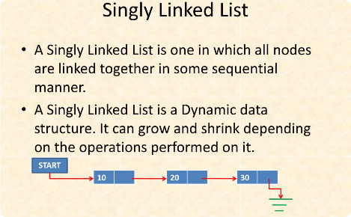
Types of Linked Lists
Singly Linked List
A basic linked list where each node has a reference to the next node, forming a unidirectional chain.

Slide 24
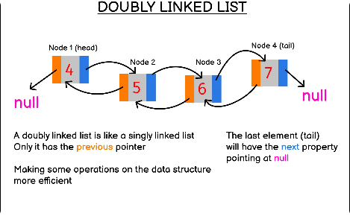
Types of Linked Lists
Doubly Linked List
Similar to a singly linked list, but each node also has a reference to the previous node, enabling bidirectional traversal.

Slide 25
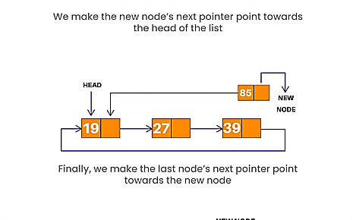
Types of Linked Lists
Circular Linked List
In this variation, the last node of the list points back to the first node, creating a circular structure.

Slide 26
Operations on a Linked List
1
Traversal
Iterate through the linked list to access and process each individual node or its data.
Insertion
2
Insert new nodes at the beginning, end, or any desired position in the linked list.
3
Deletion
Remove nodes from the linked list, adjusting pointers to ensure proper connections.
Search
4
Find specific data within the linked list by traversing the nodes and comparing their values.
5
Reversal
Reverse the order of the nodes in the linked list, altering the sequencing from head to tail.

Slide 27
Singly Linked List: Operations
struct Structure_Name{
Data_type info;
struct Structure_Name * link;
};
Node Structure
void create/append(struct node **q,int num){
struct node *temp,*r;
if(*q==NULL){
temp=(struct node*)malloc(sizeof(struct node));
temp->link=NULL;
temp->data=num;
*q=temp;
}
else{
temp=*q;
while(temp->link!=NULL)
temp=temp->link;
r =(struct node*) malloc(sizeof(struct node));
r->data=num;
r->link=NULL;
temp->link=r;
}
}
Create /Append Linear linked list

Slide 28
void addatbeg(struct node **q,int num){
struct node *temp;
temp=(struct node*)malloc(sizeof(struct node));
temp->link=*q;
temp->data=num;
*q=temp;
}
Add@Begin linear list
void addafter(struct node **q,int loc, int num){
struct node *temp,*r;
int i;
temp=*q;
for(i=0;i<loc-1;i++){
temp=temp->link;
if(temp==NULL){
printf("no. of nodes are less than the position to insert a new node");
return;
}
}
r=(struct node*)malloc(sizeof(struct node));
r->data=num;
r->link=temp->link;
temp->link=r;
}
Add@Specific Position in linear linked list

Slide 29
Singly Linked List: Operations
void delete(struct node **q,int num){
struct node *temp,*pre;
temp=*q;
while(temp!=NULL){
if(temp->data==num){
if(temp==*q)
*q=temp->link;
else
pre->link=temp->link;
free(temp);
return;
}
else{
pre=temp;
temp=temp->link;
}
}
printf("element %d not found",num);
}
Delete a node from LL
void display(struct node **q){
struct node *temp;
temp=*q;
while(temp!=NULL){
printf("%d → ",temp->data);
temp=temp->link;
}
}
Traversal of LL

Slide 30
Singly Linked List: Operations
void merge(struct node *p, struct node *q, struct node **s){
struct node *z;
z=NULL;
if(p==NULL && q==NULL)
return;
while(p!=NULL && q!=NULL){
if(*s==NULL){
*s=malloc(sizeof(struct node));
z=*s;
}
else{
z->link=malloc(sizeof(struct node));
z=z->link;
}
if(p->data<q->data){
z->data=p->data; p=p->link;
}
else if(q->data<p->data){
z->data=q->data; q=q->link;
}
else{
z->data=p->data; p=p->link; q=q->link;
}
}
while(p!=NULL){
z->link=malloc(sizeof(struct node));
z=z->link;
z->data=p->data;
p=p->link;
}
while(q!=NULL){
z->link=malloc(sizeof(struct node));
z=z->link;
z->data=q->data;
q=q->link;
}
z->link=NULL;
}

Slide 31
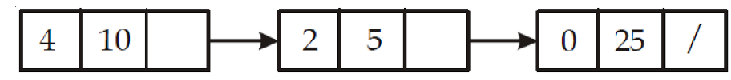
Polynomial Representation Using Linked List
void polyadditon (struct node *p, struct node *q, struct node **s){
struct node * temp;
if (q == NULL && p ==NULL){
return;
}
while ( p ! = NULL && q! = NULL){
if (*s == NULL){
*s = malloc (size of (struct node));
temp = * s;}
else{
temp → link = malloc (size of (struct node));
temp = temp → link;
}
if (p → exp < q → exp){
temp → coef = q → coef;
temp → e × p = q → e × p;
q = q → link;}
else {
if (p → exp > q → exp){
temp → coef = p → coef;
temp → exp = p → exp;
p = p → link;
}
else {
temp → coef = p + coef + q → coef;
temp → exp = q → exp;
q = q → link ;
p = p → link;
}}}
Polynomial 10x^4 + 5x^2 + 25 is represented as following:
while (p ! = NULL){
if (* s == NULL)
* s=malloc(sizeof(struct node)); temp = *s;
else {
temp → link = malloc (size of (struct node)); temp = temp → link;
}
temp → coef = p → coef;
temp → exp = p → exp;
p = p → link; }
while (q ! = NULL){
if (*s == NULL){
*s = malloc (sizeof(struct node));
temp = *s ;
}
else {
temp →link=malloc(sizeof(struct node));
}
}
}

Slide 32
Common Problems and Challenges with Linked Lists
1
Memory Overhead
2
Traversal Complexity
3
Unsuitable for Random Access
Each node in a linked list requires additional memory for the data payload and the next/previous node pointers.
Locating a specific node in a linked list requires iterating through the nodes from the beginning until the desired node is found.
Unlike arrays, linked lists do not support direct access to elements based on their indices, slowing down element retrieval.

Slide 33
Dynamic Memory Allocation:
Implementation of Stacks, Queues, Trees, and Graphs:
Symbol Table in Compilers:
Symbol tables store information about variables, functions, and other symbols in a program, and linked lists facilitate efficient management and retrieval of this information.
Dynamic Memory Management in Operating Systems:
In operating systems, linked lists are commonly used to manage free blocks of memory.
Memory allocation and deallocation can be efficiently handled by maintaining linked lists of free memory blocks.
Music Player Playlist:
Linked lists are suitable for representing playlists in music players.
Each node in the linked list represents a song, and the links between nodes define the order of the playlist.
Hash Table Chaining:
Linked lists are used in combination with hash tables for collision resolution through chaining.
In case of a hash collision, elements with the same hash value can be stored in a linked list attached to the corresponding hash table index.
Polynomial Representation:
Linked lists can be used to represent polynomials efficiently.
Each node represents a term in the polynomial, with the links indicating the degree of the term.
Job Scheduling in Operating Systems:
Linked lists are employed in job scheduling algorithms in operating systems.
Each node represents a job, and the links define the scheduling order.
Applications of linked list

Slide 34


Consider the problem of reversing a singly linked list. To take an example, given the linked list below:
the reversed linked list should look like
Which one of the following statements is TRUE about the time complexity of algorithms that solve the above problem in O(1) space?
GATE CSE 2022
The best algorithm for the problem takes 0(n) time in the worst case.
The best algorithm for the problem takes 0(n log n) time in the worst case.
The best algorithm for the problem takes 0(n^2) time in the worst case.
It is not possible to reverse a singly linked list in 0(1) space.

Slide 35
Let P be a singly linked list, Let Q be the pointer to an intermediate node x in the list. What is the worst-case time complexity of the best known algorithm to delete the node x from the list?
GATE CSE 2004
O(n)
O(log^2 n)
O(log n)
O(1)

Slide 36
Stack & Applications

Slide 37
Stack
Basic principles
Operation of stack
Stack using Array
Stack using Linked List
Applications of stack

Slide 38

Basic Idea
A stack is an Abstract Data Type (ADT), commonly used in most programming languages. It is named stack as it behaves like a real-world stack, for example – a deck of cards or a pile of plates, etc.

Slide 39
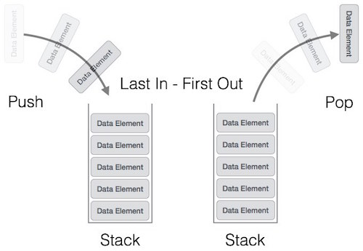
Stack Representation
Can be implemented by means of Array, Structure, Pointers and Linked List.
Stack can either be a fixed size or dynamic.

Slide 40
push
STACK
pop
create
isempty
isfull

Slide 41
STACK: Last-In-First-Out (LIFO)
void push (stack *s, int element);
/* Insert an element in the stack */
int pop (stack *s);
/* Remove and return the top element */
void create (stack *s);
/* Create a new stack */
int isempty (stack *s);
/* Check if stack is empty */
int isfull (stack *s);
/* Check if stack is full */
Assumption: stack contains integer elements!

Slide 42
Stack using Array

Slide 43
Push using Stack
PUSH
top
top

Slide 44
Pop using Stack
POP
top
top

Slide 45
Stack using Linked List

Slide 46
Push using Linked List
PUSH OPERATION
top

Slide 47
Pop using Linked List
POP OPERATION
top

Slide 48
Basic Idea
In the array implementation, we would:
Declare an array of fixed size (which determines the maximum size of the stack).
Keep a variable which always points to the “top” of the stack.
Contains the array index of the “top” element.
In the linked list implementation, we would:
Maintain the stack as a linked list.
A pointer variable top points to the start of the list.
The first element of the linked list is considered as the stack top.

Slide 49
Declaration
#define MAXSIZE 100
struct lifo
{
int st[MAXSIZE];
int top;
};
struct lifo stack;
struct lifo
{
int value;
struct lifo *next;
};
struct lifo *top;
ARRAY
LINKED LIST

Slide 50
Stack Creation
void create (stack *s)
{
s->top = -1;
/* s->top points to
last element
pushed in;
initially -1 */
}
void create (stack **top)
{
*top = NULL;
/* top points to NULL,
indicating empty
stack */
}
ARRAY
LINKED LIST

Slide 51
Pushing an element into stack
void push (stack *s, int element)
{
if (s->top == (MAXSIZE-1))
{
printf (“\n Stack overflow”);
exit(-1);
}
else
{
s->top++;
s->st[s->top] = element;
}
}
void push (stack **top, int element)
{
stack *new;
new = (stack *)malloc (sizeof(stack));
if (new == NULL)
{
printf (“\n Stack is full”);
exit(-1);
}
new->value = element;
new->next = *top;
*top = new;
}
ARRAY
LINKED LIST

Slide 52
Popping an element from stack
int pop (stack *s)
{
if (s->top == -1)
{
printf (“\n Stack underflow”);
exit(-1);
}
else
{
return (s->st[s->top--]);
}
}
int pop (stack **top){
int t;
stack *p;
if (*top == NULL)
{
printf (“\n Stack is empty”);
exit(-1);
}
else {
t = (*top)->value;
p = *top;
*top = (*top)->next;
free (p);
return t;
}
}
ARRAY
LINKED LIST

Slide 53
Checking for stack empty
int isempty (stack *s)
{
if (s->top == -1)
return 1;
else
return (0);
}
int isempty (stack *top)
{
if (top == NULL)
return (1);
else
return (0);
}
ARRAY
LINKED LIST

Slide 54
Checking for Stack Full
int isfull (stack *s)
{
if (s->top == (MAXSIZE-1))
{
printf (“\n Stack overflow”);
return 1;
}
else
return (0);
}
int isfull (stack *top)
{
stack *new;
new = (stack *)malloc (sizeof(stack));
if (new == NULL)
{
printf (“\n Stack is full”);
return (1);
else
return (0);
}
ARRAY
LINKED LIST

Slide 55
Example: A Stack using an Array
#include <stdio.h>
#define MAXSIZE 100
struct lifo{
int st[MAXSIZE];
int top;
};
typedef struct lifo stack;
main() {
stack A, B;
create(&A);
create(&B);
push(&A,10);
push(&A,20);
push(&A,30);
push(&B,100);
push(&B,5);
printf (“%d %d”, pop(&A), pop(&B));
push (&A, pop(&B));
if (isempty(&B))
printf (“\n B is empty”);
return;
}

Slide 56
Example: A Stack using Linked List
#include <stdio.h>
struct lifo
{
int value;
struct lifo *next;
};
typedef struct lifo stack;
main() {
stack *A, *B;
create(&A);
create(&B);
push(&A,10);
push(&A,20);
push(&A,30);
push(&B,100);
push(&B,5);
printf (“%d %d”, pop(&A), pop(&B));
push (&A, pop(&B));
if (isempty(B))
printf (“\n B is empty”);
return;
}

Slide 57
Applications of Stacks
Page-visited history in a Web browser
Undo sequence in a text editor
Chain of method calls in the Java Virtual Machine
Function-call abstraction
Validate XML
Auxiliary data structure for algorithms
Evaluation of Arithmetic expressions
Polish Notation conversion
To manage the Symbol table in compile design.
Balanced Parenthesis in arithmetic expressions.

Slide 58
What is stack size estimation❓
Stack size estimation is process of determining the amount of memory allocated to the call stack for a particular program or thread. The call stack is a region of memory that operates on a Last In, First Out (LIFO) basis and is used for managing function calls and local variables.
Here are some key points related to stack size estimation:
Function Calls: Each time a function is called, a new stack frame is created, which includes space for local variables, return addresses, and other information related to the function call.
Recursion: Recursive functions can lead to a significant increase in the stack size, as each recursive call adds a new stack frame. The depth of recursion directly impacts the stack size required.
Local Variables: The size of local variables within functions contributes to the overall stack size. Larger local variables or arrays can consume more stack space.
Thread Stack Size: In a multithreaded program, each thread typically has its own stack. The stack size for each thread specified during thread creation. Estimating the required stack size is crucial to prevent stack overflow.
Operating System Limits: Operating systems often impose limits on the maximum stack size for a thread. Exceeding these limits can result in a stack overflow, leading to program termination.
Platform and Compiler Considerations: Stack size can vary across different platforms and compilers. It's important for developers to be aware of the characteristics of the target environment and adjust stack sizes accordingly.

Slide 59
A single array A[1..MAXSIZE] is used to implement two stacks, The two stacks grow from opposite ends of the array. Variables top1 and top2 (top1 < top2) point to the location of the topmost element in each of the stacks, If the space is to be used efficiently, the condition for "stack full" is
GATE CSE 2004
(top 1 = MAXSIZE/2) AND (top 2 = MAXSIZE/2+1)
top 1 + top 2 = MAXSIZE
(top 1 = MAXSIZE/2) or (top 2 = MAXSIZE)
top 1 = top 2-1

Slide 60

Queue and Its Applications

Slide 61
Queue
Basic principles
Operation of queue
Queue using Array
Queue using Linked List
Applications of queue

Slide 62
Basic Idea
Queue is an abstract data structure, somewhat similar to Stacks. Unlike stacks, a queue is open at both its ends. One end is always used to insert data (enqueue) and the other is used to remove data (dequeue). Works on FIFO-first in first out.

Slide 63
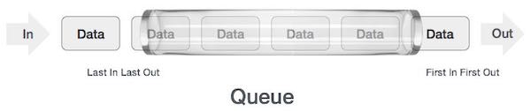
Queue Representation
As in stacks, a queue can also be implemented using Arrays, Linked-lists, Pointers and Structures.

Slide 64
enqueue
QUEUE
dequeue
create
isempty
size

Slide 65
QUEUE: First-In-First-Out (FIFO)
void enqueue (queue *q, int element);
/* Insert an element in the queue */
int dequeue (queue *q);
/* Remove an element from the queue */
queue *create();
/* Create a new queue */
bool isempty (queue *q);
/* Check if queue is empty */
int size (queue *q);
/* Return the no. of elements in queue */
Assumption: queue contains integer elements!

Slide 66
Queue using Linked List

Slide 67
Basic Idea
Create a linked list to which items would be added to one end and deleted from the other end.
Two pointers will be maintained:
One pointing to the beginning of the list (point from where elements will be deleted).
Another pointing to the end of the list (point where new elements will be inserted).
Rear
Front
DELETION
INSERTION

Slide 68
Queue: Linked List Structure
ENQUEUE
front
rear

Slide 69
Queue: Linked List Structure
DEQUEUE
front
rear

Slide 70
Example :Queue using Linked List
struct qnode
{
int val;
struct qnode *next;
};
struct queue
{
struct qnode *qfront, *qrear;
};
typedef struct queue QUEUE;
void enqueue (QUEUE *q,int element)
{
struct qnode *q1;
q1=(struct qnode *)malloc(sizeof(struct qnode));
q1->val= element;
q1->next=q->qfront;
q->qfront=q1;
}

Slide 71
Example :Queue using Linked List
int size (queue *q)
{
queue *q1;
int count=0;
q1=q;
while(q1!=NULL)
{
q1=q1->next;
count++;
}
return count;
}
int dequeue (queue *q)
{
struct qnode *temp;
int item;
if (q->front == NULL){
printf("\nQueue is empty.");
return NULL;
}
item = q->front->val;
temp = q->front;
q->front = q->front->next;
free(temp);
return item;
}
int peek (queue *q)
{
queue *q1;
q1=q;
while(q1->next!=NULL)
q1=q1->next;
return (q1->val);
}

Slide 72
Problem With Array Implementation
The size of the queue depends on the number and order of enqueue and dequeue.
It may be situation where memory is available but enqueue is not possible.
ENQUEUE
DEQUEUE
Effective queuing storage area of array gets reduced.
0
N
front
front
rear
rear
Use of circular array indexing

Slide 73
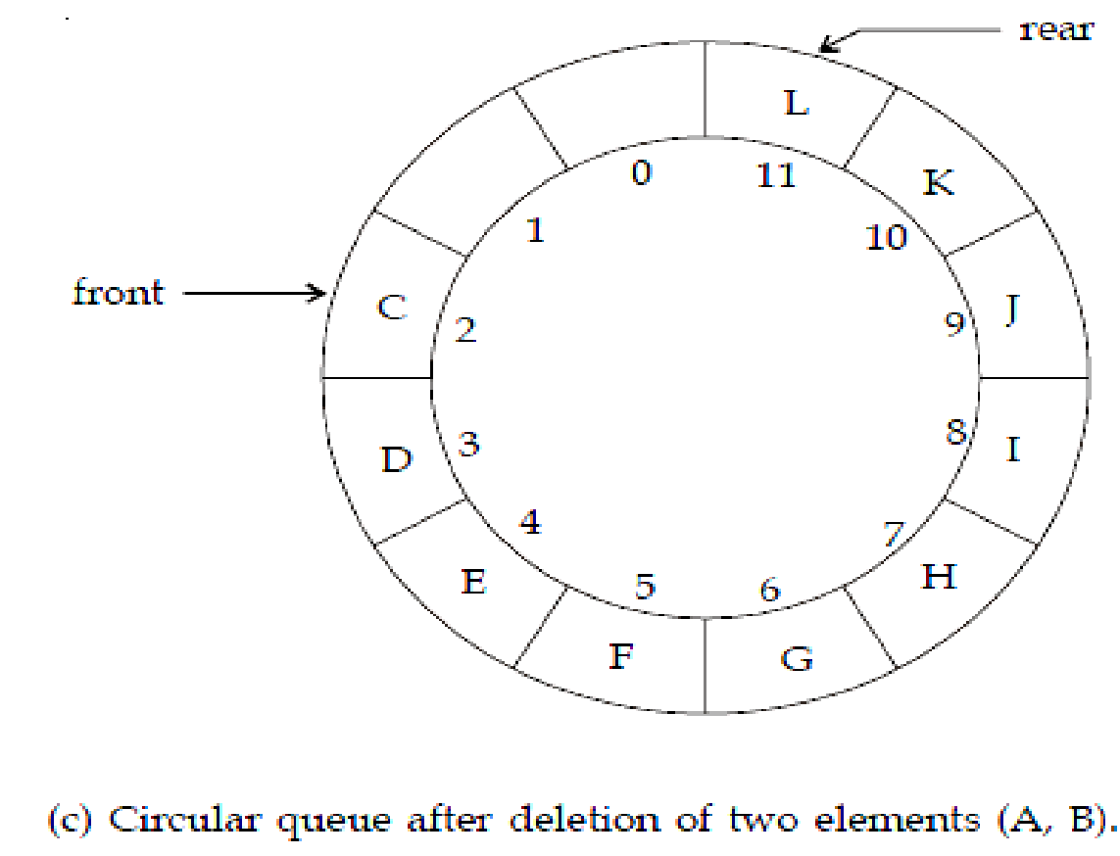
Circular Queue

Slide 74
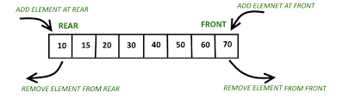
Deque: Double Ended Queue

Slide 75
Applications of Queues
Waiting lists
Access to shared resources (e.g., printer)
Auxiliary data structure for algorithms
Data items to transfer through a Router on a network,
To manage the ready queue, waiting queue, etc. for the execution of a task in CPU scheduling
Job sequencing through an operating system,
Priority management of the different tasks
Manage Time-sharing system.
Buffering data in I/O systems
Producer-consumer problem
Thread synchronization
Graph Applications: BFS, Dijkstra's algorithm
Traffic management

Slide 76
Applications
Queue using Two Stacks
LRU Cache
Detect cycle in an undirected graph using BFS
Breadth First Search or BFS for a Graph
Print Right View of a Binary Tree
Find Minimum Depth of a Binary Tree
Flatten a multilevel linked list
Minimum time required to rot all oranges

Slide 77
GATE DA PYQ

Slide 78
A queue is implemented using an array such that ENQUEUE and DEQUEUE operations are performed efficiently. Which one of the following statements is CORRECT (n refers to the number of items in the queue)?
GATE CSE 2016 | set1
Both operations can be performed in O(1) time
At most one operation can be performed in O(1) time but the worst case time for the other operation will be Ω(n)
The worst case time complexity for both operations will be Ω(n)
Worst case time complexity for both operations will be Ω(log n)

Slide 79
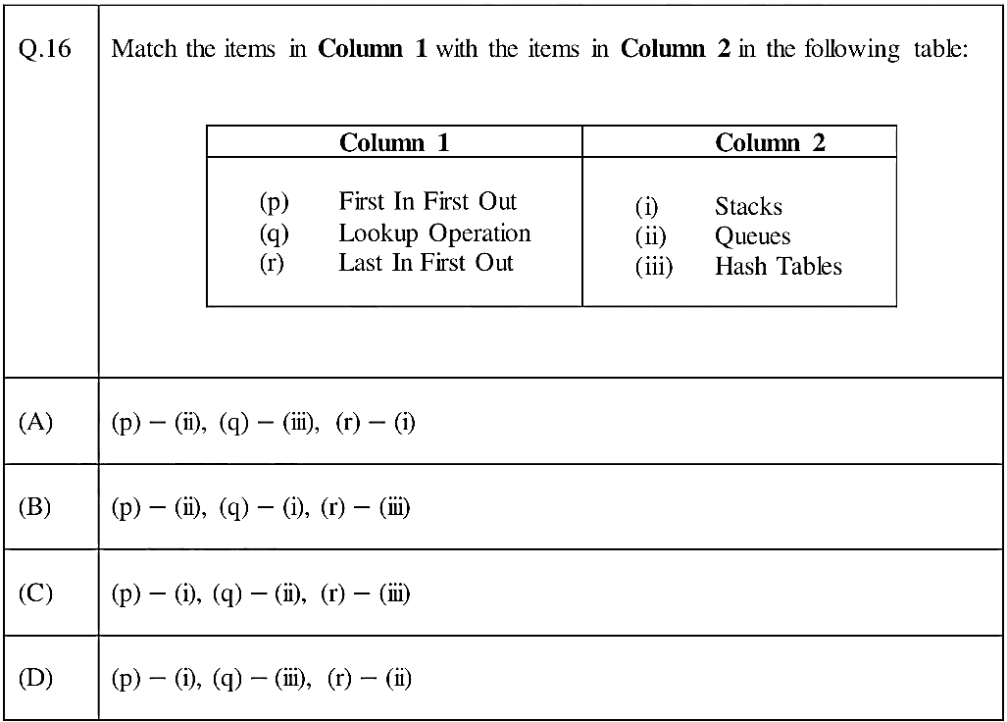
Gate DA -2024

Slide 80
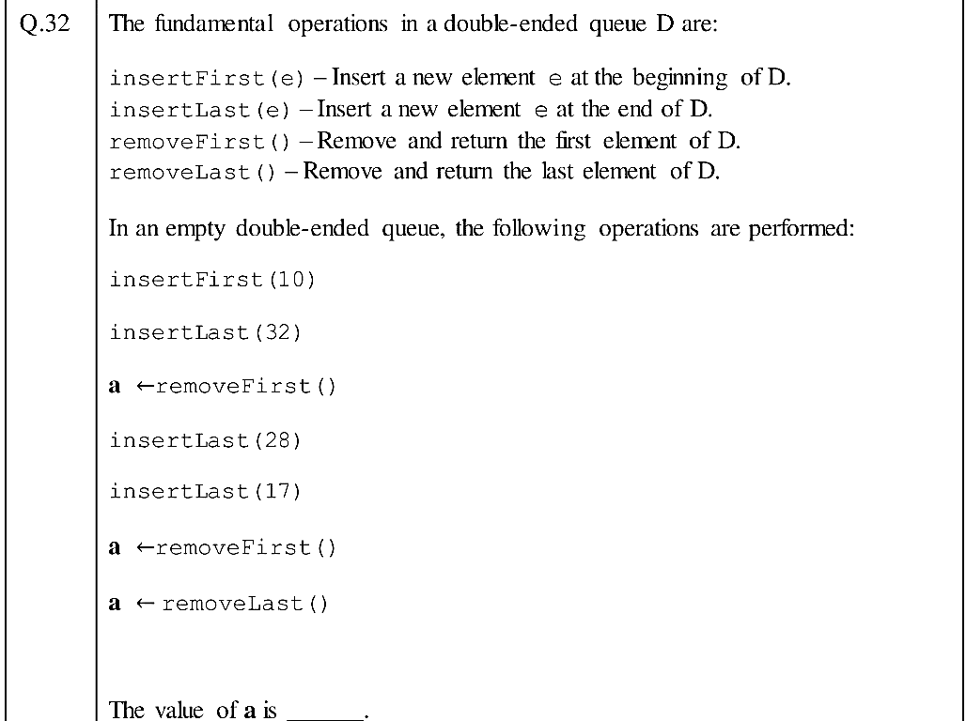
Gate DA -2024

